Slide 1
IPL

Slide 2
Aggressive Batsmen
select batsman,
sum(total_runs) as runs ,
count(case when extras_type = 'wide' then 0 else ball end) as balls_faced,
round(((sum(total_runs)* 100)::float/(count(case when extras_type = 'wide' then 0 else ball end))::float):: numeric, 2)as strike_rate
from Deliveries
group by batsman
having count(case when extras_type = 'wide' then 0 else ball end) >= 500
order by strike_rate desc
limit 10;

Slide 3
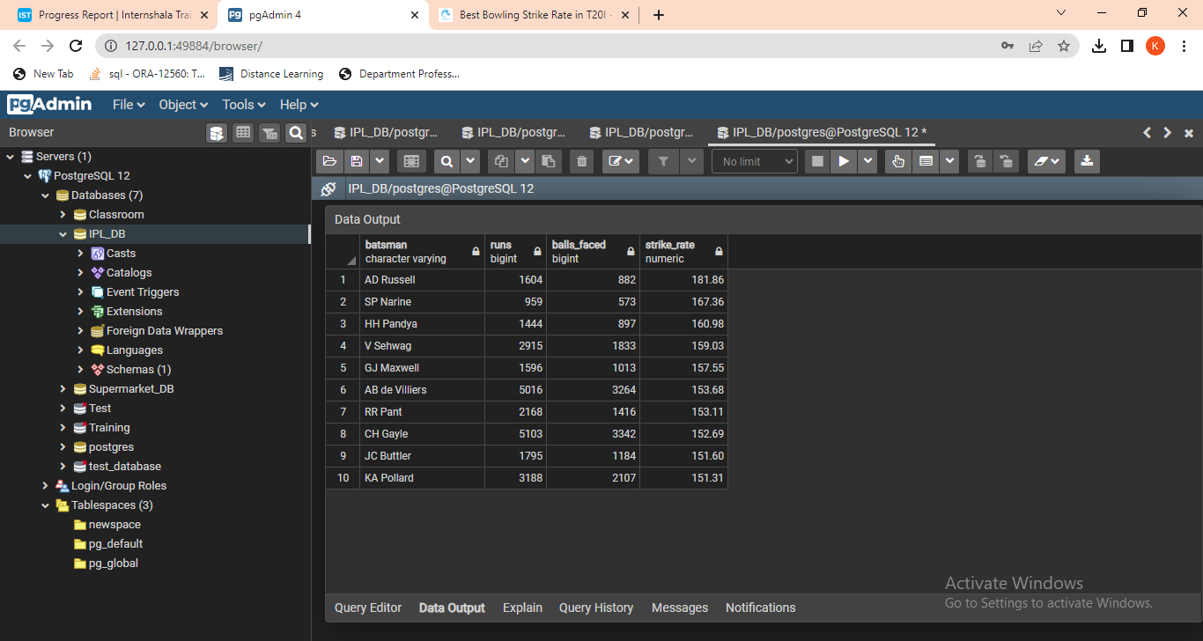

Slide 5
Anchor Batsman
select batsman as anchor_batsman,
sum(batsman_runs) as runs,
(sum(batsman_runs)::float/Nullif(count(case when is_wicket <> 0 then is_wicket End),0)) as average
from Deliveries
join Matches on Deliveries.id = Matches.match_id
group by batsman
having (count(case when is_wicket <> 0 then is_wicket End)) > 0 and count(distinct extract ('year' from date) ) > 2
order by average desc
limit 10;

Slide 6
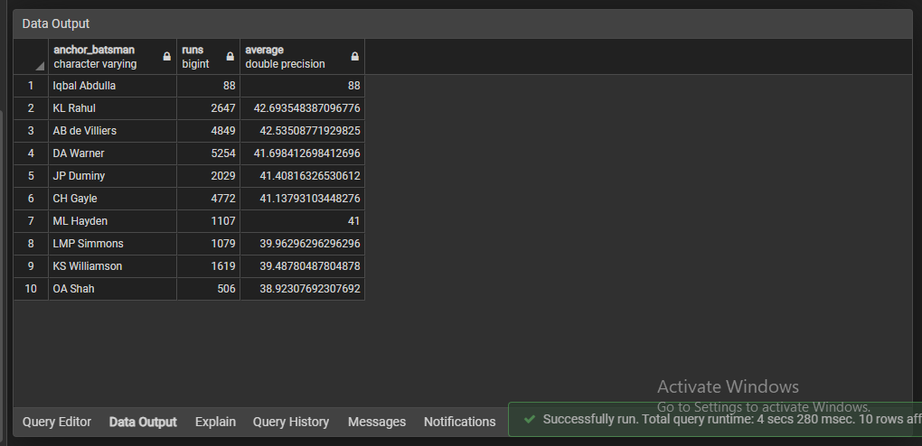

Slide 7
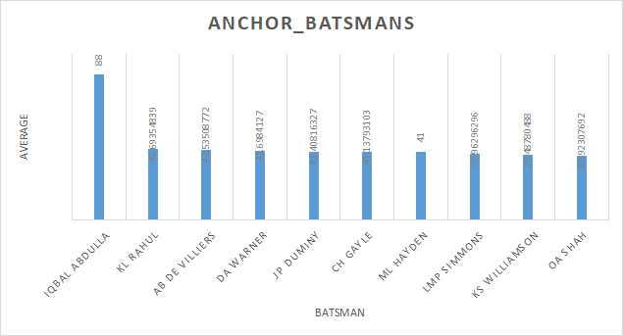

Slide 8
Hard-hitting players
select batsman ,
sum(batsman_runs) as runs,
count (case when(batsman_runs in (4,6)) then 1 end) as boundry_count,
(select sum(batsman_runs) from Deliveries where batsman_runs in (4, 6)) as boundry_runs,
sum(select sum(batsman_runs) from Deliveries where batsman_runs in (4, 6))/ (NULLIF(sum(batsman_runs),0)) as boundry_percentage
from Deliveries
JOIN Matches ON Deliveries.id = Matches.match_id
group by batsman
having count(EXTRACT('Year' FROM Matches.date) ) > 2
order by boundry_percentage desc
limit 10;

Slide 9
Economical Bowlers
select bowler,
count(ball)/6 as total_overs,
round((sum(total_runs)/(count(ball)/6::float))::numeric, 2) as economy
from Deliveries
group by bowler
having count(ball) >= 500
order by economy asc
limit 10;

Slide 10
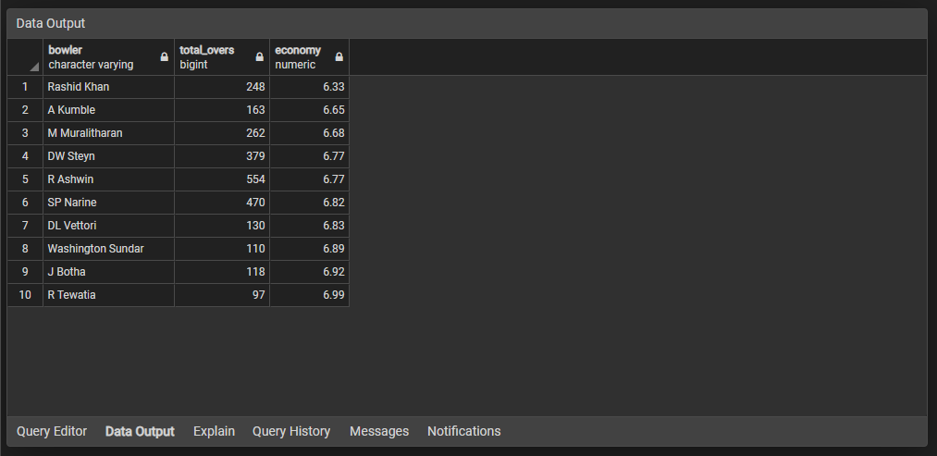

Slide 11
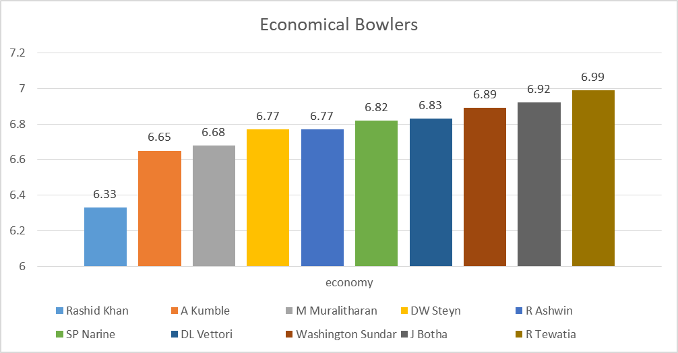

Slide 12
Wicket Taking Bowlers
select bowler,
count(ball) as ball_delivered ,
sum(is_wicket) as wickets,
round((count(ball)::float/sum(is_wicket)::float) :: numeric,2) as strike_rate
from Deliveries
group by bowler
having count(ball) >= 500
order by strike_rate asc
limit 10;

Slide 13
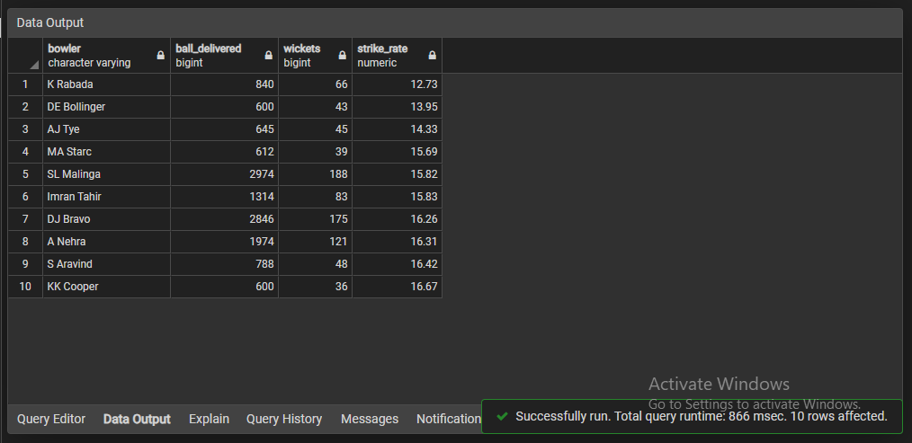

Slide 14
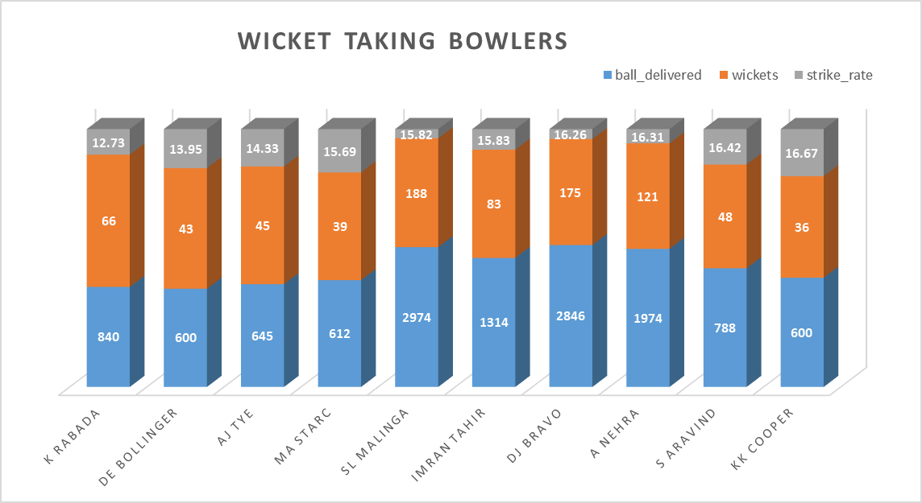

Slide 15
All Rounder's
SELECT
a.batsman AS all_rounder,
a.total_runs,
a.balls_faced,
ROUND((a.total_runs ::float / a.balls_faced::float * 100)::numeric, 2) AS strike_rate_batsman,
b.balls_bowled,
b.wickets_taken,
b.strike_rate_bowler
FROM
(SELECT
batsman,
SUM(batsman_runs) AS total_runs,
COUNT(CASE WHEN extras_type = 'wides' THEN NULL ELSE ball END) AS balls_faced

Slide 16
FROM deliveries
GROUP BY batsman
HAVING COUNT(CASE WHEN extras_type = 'wides' THEN NULL ELSE ball END) >= 500) AS a
INNER JOIN
(SELECT
bowler,
COUNT(ball) AS balls_bowled,
SUM(is_wicket) AS wickets_taken,
ROUND((COUNT(ball) / SUM(is_wicket)::float)::numeric, 2) AS strike_rate_bowler
FROM deliveries
GROUP BY bowler
HAVING COUNT(ball) >= 300) AS b
ON a.batsman = b.bowler
ORDER BY strike_rate_batsman DESC
LIMIT 10;

Slide 17
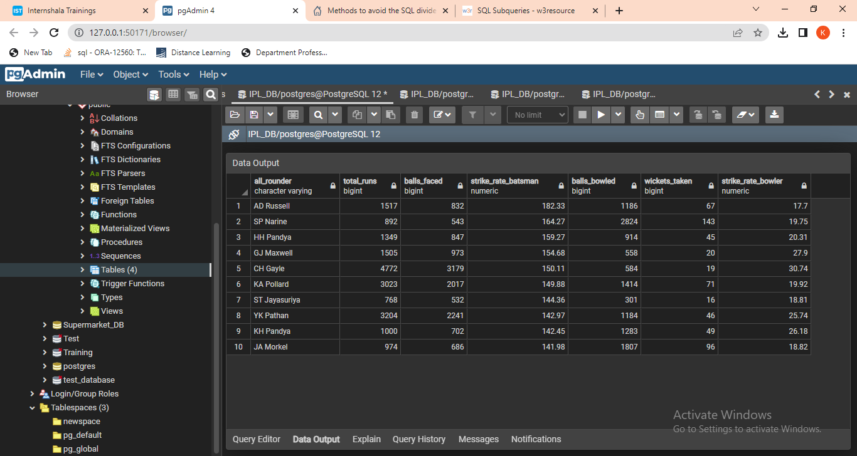

Slide 19
Wicket Keepers
In T20, the emphasis is on scoring runs quickly, so the wicketkeeper is often expected to contribute to the team's run total with aggressive batting. They may also be called upon to bowl a few overs of spin or medium pace.
Stamina is another important factor in being a successful Wicket Keeper. For fulfilling the multi-dimensional needs of T20, a WK needs to be strong with his basics too. The glove work must be sharpened and the quick movement behind the stumps must be molded.
So, select a player having good medium strike rate in batting and who can also do balling whenever necessary
choose 2-3 players having good strike rate and have balled at least 200 balls.
Create query that can provide us atleast 10 such players from which we can select our wicket keeper for team.

Slide 20
Additional Questions

Slide 21
Create table Queries
CREATE TABLE Deliveries
(
id integer,
inning integer,
over integer,
ball integer,
batsman varchar,
non_striker varchar,
bowler varchar,
batsman_runs integer,
extra_runs integer,
total_runs integer,
is_wiket integer,
dismissal_kind varchar,
player_dismissed varchar,
fielder varchar,
extras_type varchar,
batting_team varchar,
bowling_team varchar
);

Slide 22
CREATE TABLE Matches
(
match_id integer,
cit varchar,
date date,
player_of_match varchar,
venue varchar,
neutral_venue integer,
team1 varchar,
team2 varchar,
toss_winner varchar,
toss_decision varchar,
winner varchar,
result varchar,
result_mrgin integer,
eliminator varchar,
method varchar,
umpire1 varchar,
umpire2 varchar
);

Slide 23
1. Get the count of cities that have hosted an IPL match
select count(distinct city) as city_count
from Matches;

Slide 24
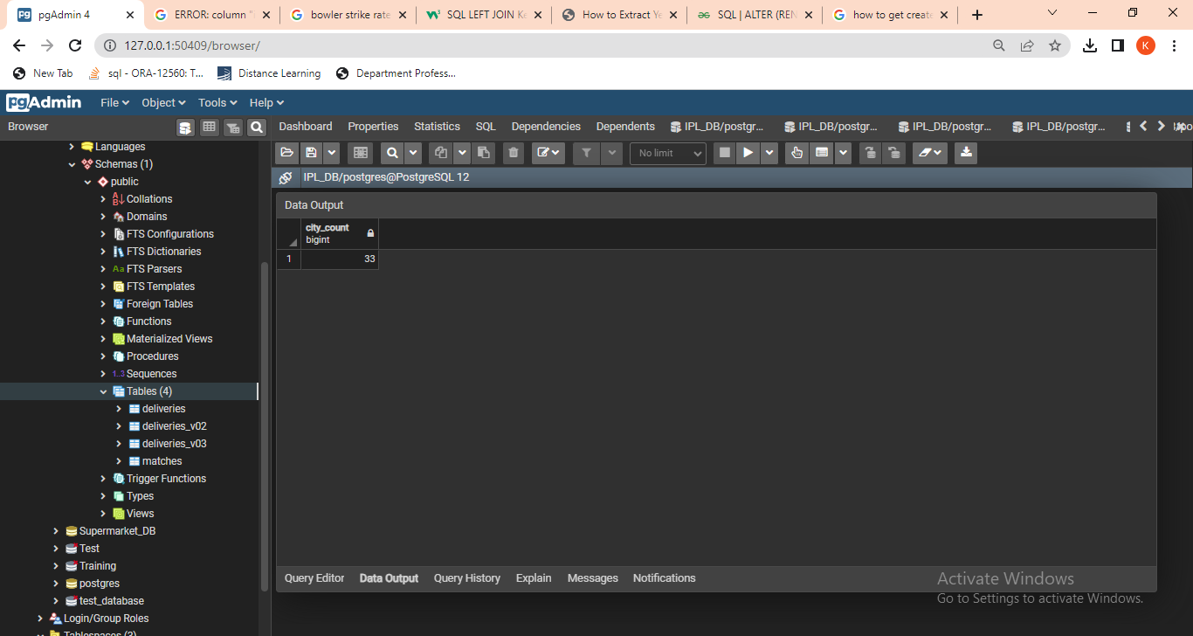
OUTPUT:

Slide 25
2. Create table deliveries_v02 with all the columns of the table ‘deliveries’ and an additional column ball_result containing values boundary, dot or other depending on the total_run (boundary for >= 4, dot for 0 and other for any other number) (Hint 1 : CASE WHEN statement is used to get condition based results) (Hint 2: To convert the output data of the select statement into a table, you can use a subquery. Create table table_name as [entire select statement].
QUERY 1:
create table deliveries_v02
as
(select * ,
case
when batsman_runs >= 4 then 'Boundry'
when batsman_runs = 0 then 'Dot'
else 'Other'
end as ball_result
from Deliveries
)

Slide 26
ALTERNATE QUERY 2:
create table deliveries_v02
as select *
from Deliveries;
select *,
case
when batsman_runs >= 4 then 'Boundry'
when batsman_runs = 0 then 'Dot'
else 'Other'
end as ball_result
from deliveries_v02;

Slide 27
3. Write a query to fetch the total number of boundaries and dot balls from the deliveries_v02 table.
QUERY 1:
select count(ball_result)
from deliveries_v02
where ball_result = 'Boundry' OR ball_result = 'Dot';
ALTERNATE QUERY 2:
select count(ball_result)
from deliveries_v02
where ball_result = 'Dot';
select count(ball_result)
from deliveries_v02
where ball_result = 'Boundry';

Slide 28
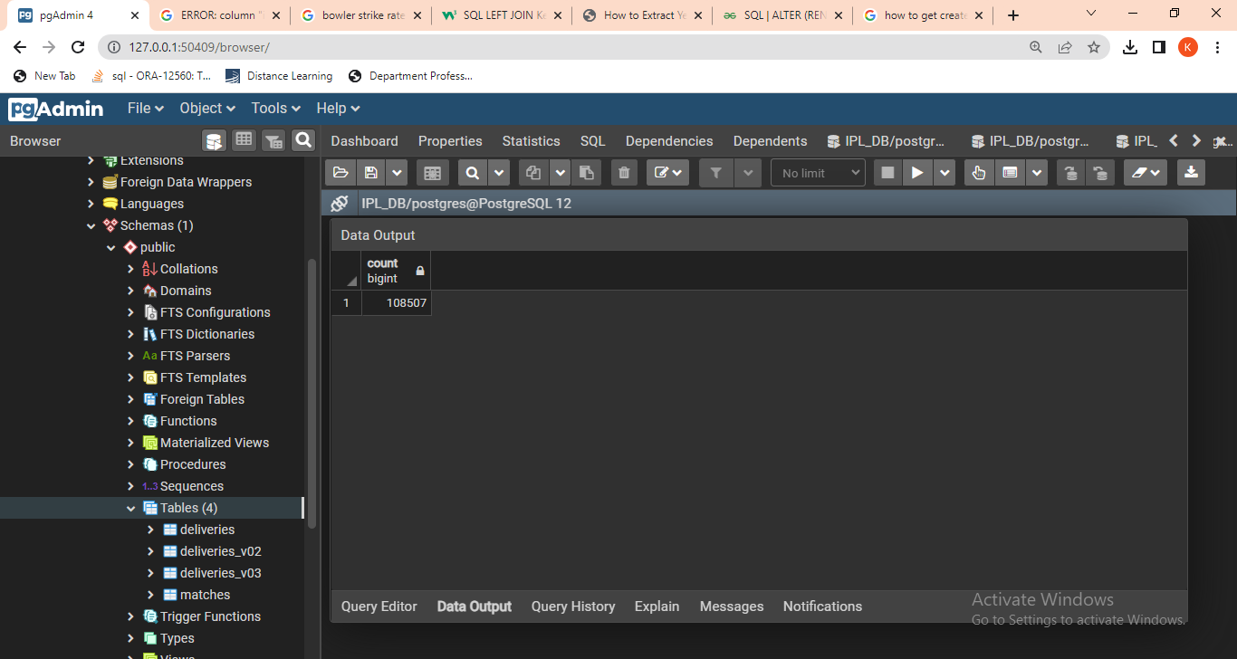
QUERY 1 OUTPUT : Boundary and Dot ball Count

Slide 29
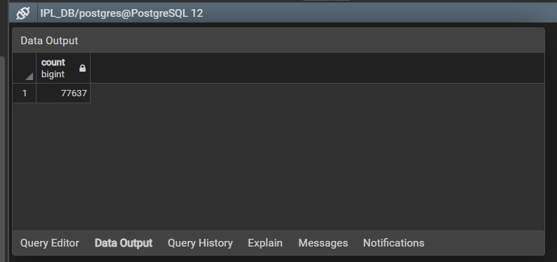
QUERY 2 OUTPUT : Dot Ball Count

Slide 30
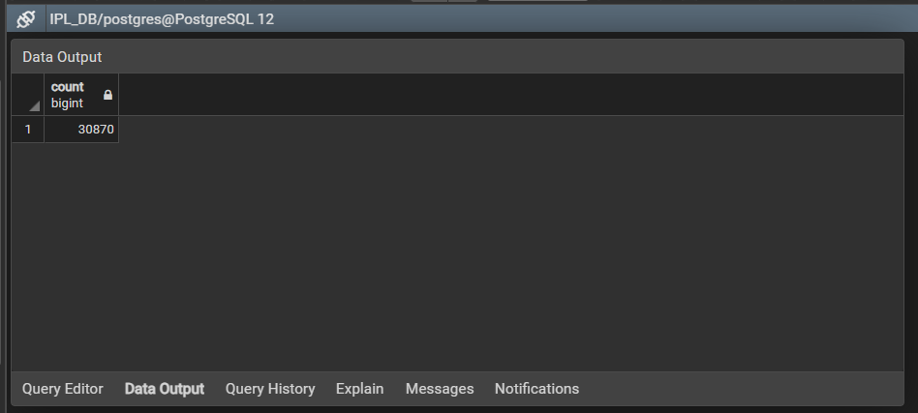
Boundary Ball Count

Slide 31
4. Write a query to fetch the total number of boundaries scored by each team from the deliveries_v02 table and order it in descending order of the number of boundaries scored.
select batting_team, count(ball_result) as boundry_count
from deliveries_v02
where ball_result = 'Boundry'
group by batting_team
order by boundry_count desc;

Slide 32
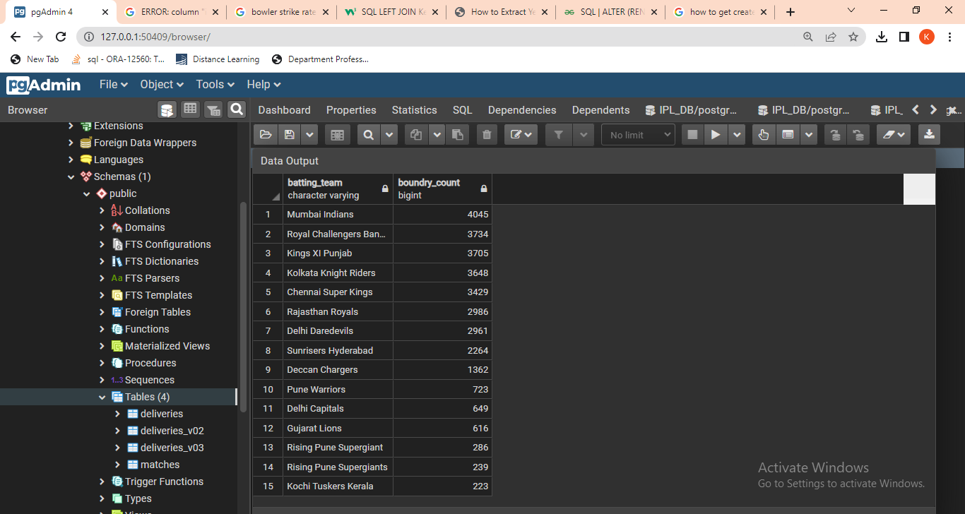

Slide 33
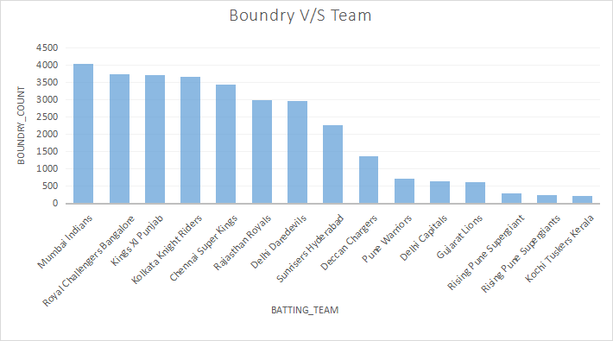

Slide 34
5. Write a query to fetch the total number of dot balls bowled by each team and order it in descending order of the total number of dot balls bowled.
select bowling_team, count(ball_result) as dot_count
from deliveries_v02
where ball_result = 'Dot'
group by bowling_team
order by dot_count desc;

Slide 35
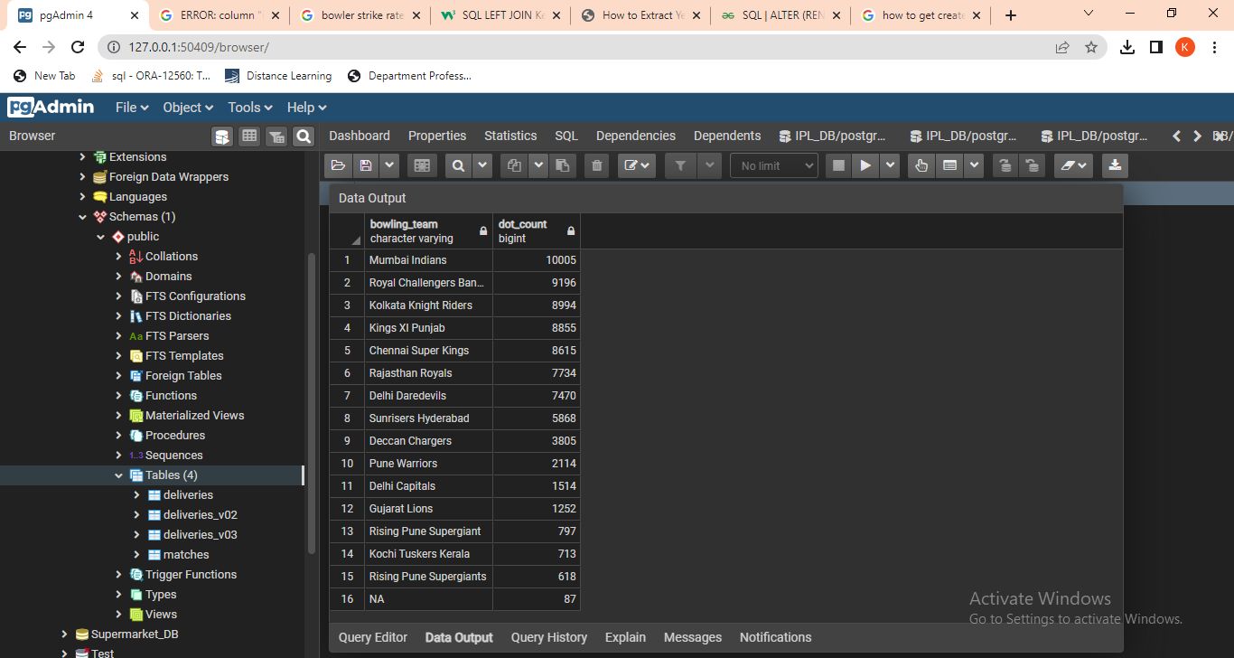

Slide 36
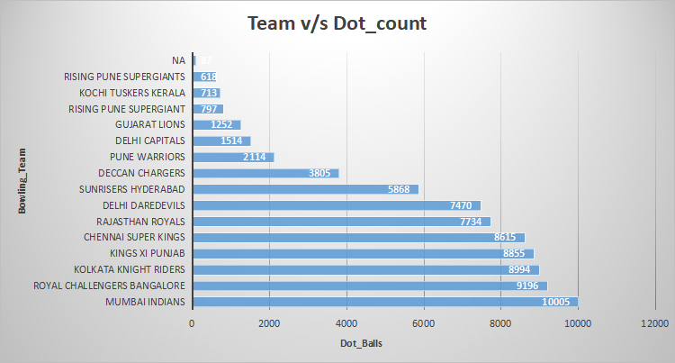

Slide 37
6. Write a query to fetch the total number of dismissals by dismissal kinds where dismissal kind is not NA
QUERY 1 USING Deliveries TABLE:
select count(dismissal_kind) as total_dismissal
from Deliveries
where not dismissal_kind = 'NA';
QUERY 2 USING deliveries_v02 TABLE:
select count(dismissal_kind) as dismissals
from deliveries_v02
where not dismissal_kind = 'NA';

Slide 38
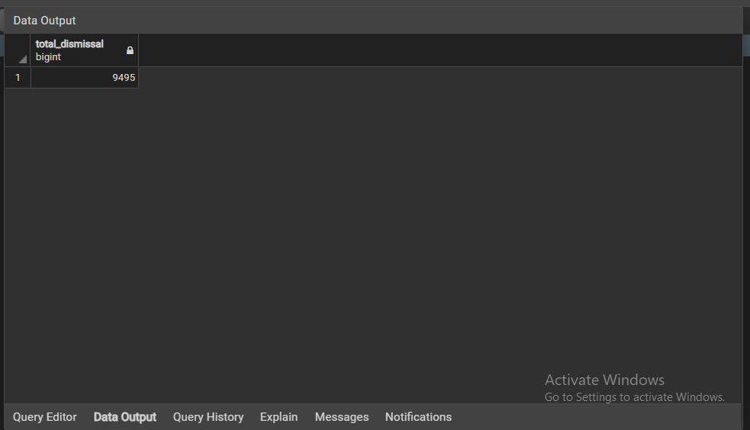

Slide 39
7. Write a query to get the top 5 bowlers who conceded maximum extra runs from the deliveries table
select bowler, sum(extra_runs) as extra_runs
from Deliveries
group by bowler
order by extra_runs desc
limit 5;

Slide 40
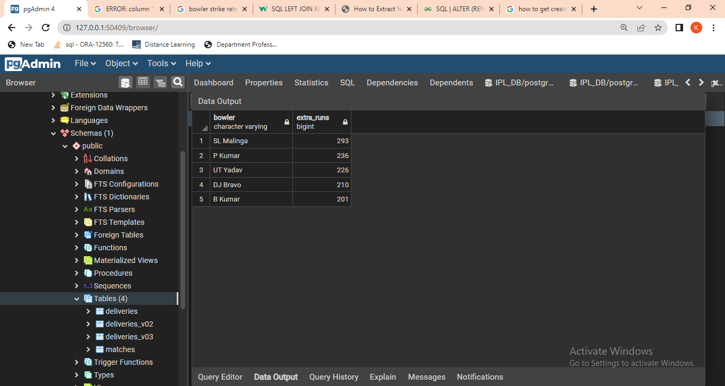

Slide 42
8. Write a query to create a table named deliveries_v03 with all the columns of deliveries_v02 table and two additional column (named venue and match_date) of venue and date from table matches
create table deliveries_v03
as
(
select deliveries_v02.*, Matches.date, Matches.venue
from deliveries_v02
left join Matches on deliveries_v02.id = Matches.match_id
)

Slide 43
9. Write a query to fetch the total runs scored for each venue and order it in the descending order of total runs scored.
select venue, sum(total_runs) as total_runs
from deliveries_v03
group by venue
order by total_runs desc;

Slide 44
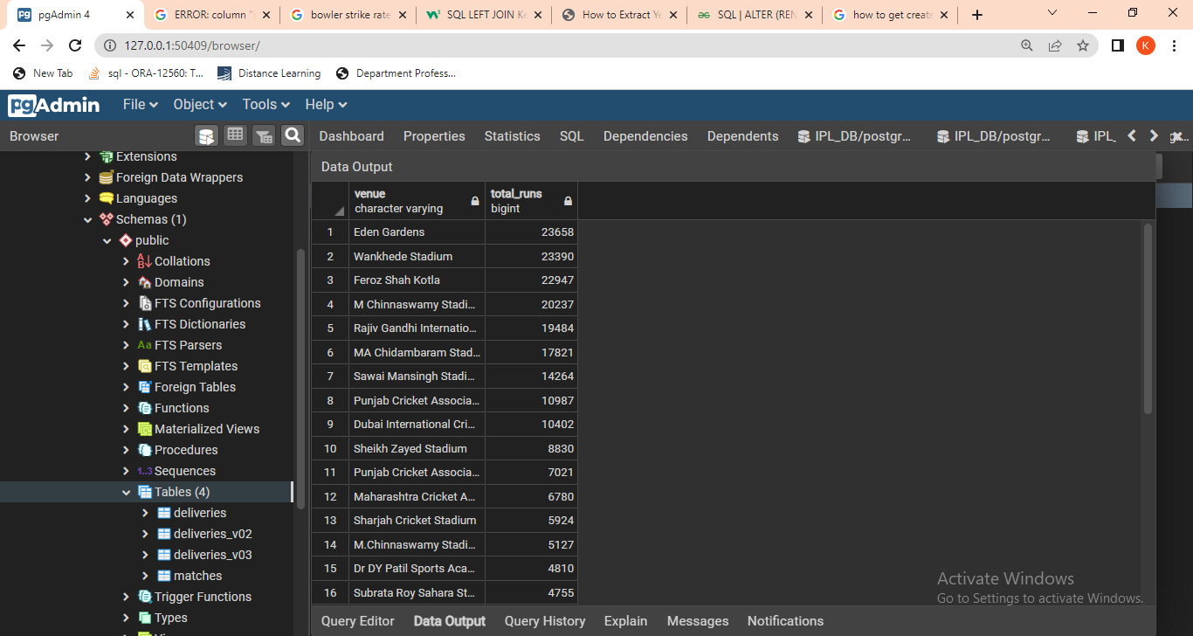

Slide 45
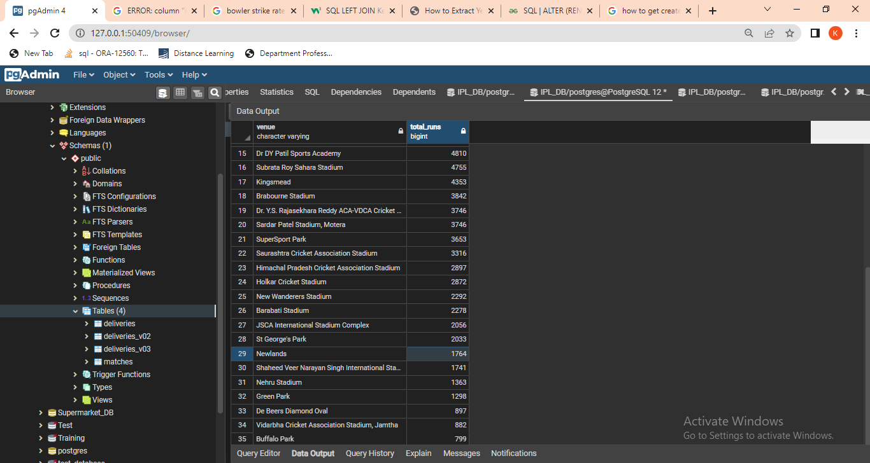

Slide 47
10. Write a query to fetch the year-wise total runs scored at Eden Gardens and order it in the descending order of total runs scored.
select EXTRACT('Year' FROM date) as year_, sum(total_runs) as total_runs
from deliveries_v03
where venue = 'Eden Gardens'
group by year_
order by total_runs desc;

Slide 48
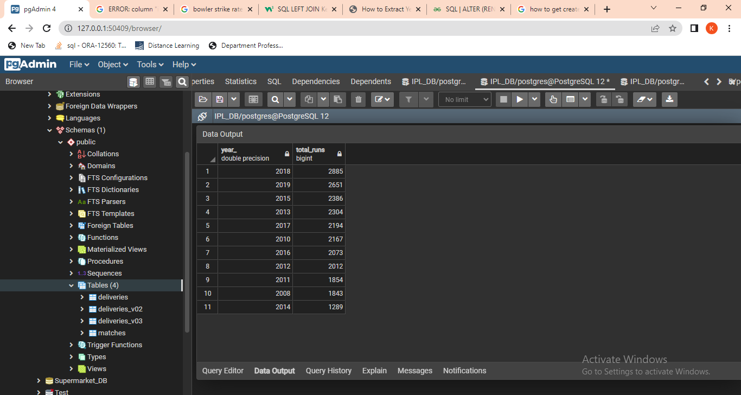

Slide 49
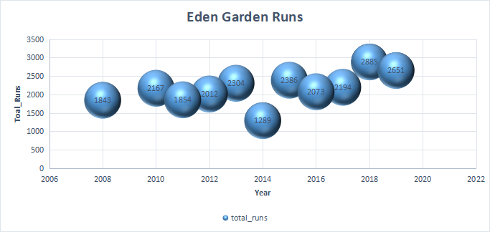

Slide 50
Thank You

